Slide 1
Bluetooth based RPM Detector
Shazni Ahmad

Slide 2
TABLE OF CONTENTS
Product overview.
Package contents.
Getting started.
Operating instructions.

Slide 3
Product overview
Bluetooth based rpm detector is a device that helps to monitor anomalies in fans by monitoring there rpm.
This specific product monitors the rpm using an IR module and it displays the value on the lcd screen.
Apart from this the product has inbuilt Bluetooth connectivity to interact with a mobile app, where the user is allowed to feed in the number of blades of the fan which is to be monitored and the value of the rpm will also be displayed on the UI of the app.

Slide 4
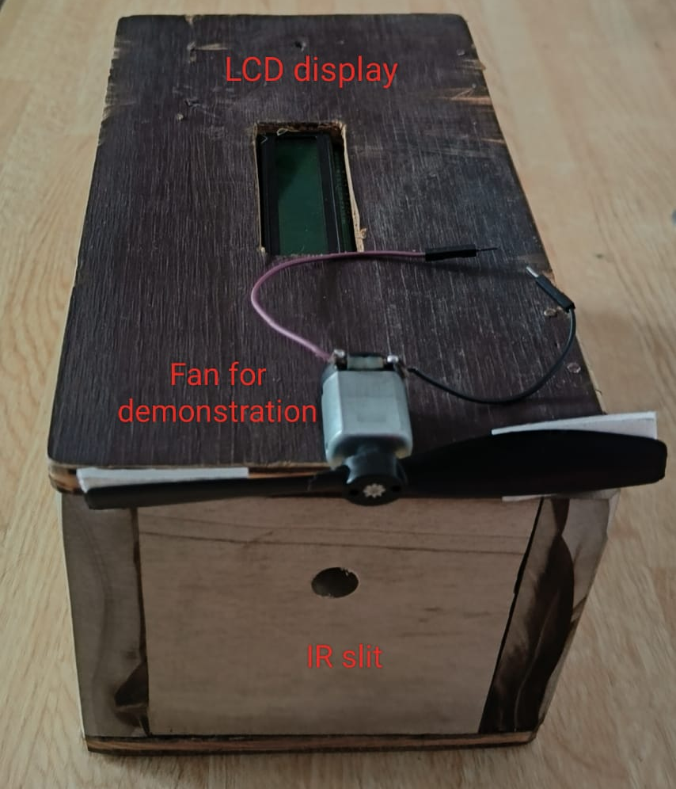
Package contents
16x2 LCD display
IR module
HC-06 Bluetooth module
Atmega32 microcontroller
PCB
3.7V rechargeable battery

Slide 5
Getting started
All you need to get started with the device is to install the Bluetooth control app
There is no requirement to power the device since the device is powered with 3.7V rechargeable battery.
All you have to do is to just press the power button of the device to start using it.

Slide 6
Operating Instructions
Initially press the power button.
Then open the Bluetooth control app.
Then enter the number of blades contained in the fan that is to be monitored.
Then point the IR slit close to the blades of the fan.
Examine the rpm value on the LCD display and the mobile app.

Slide 7
Thank You

